Slide 1
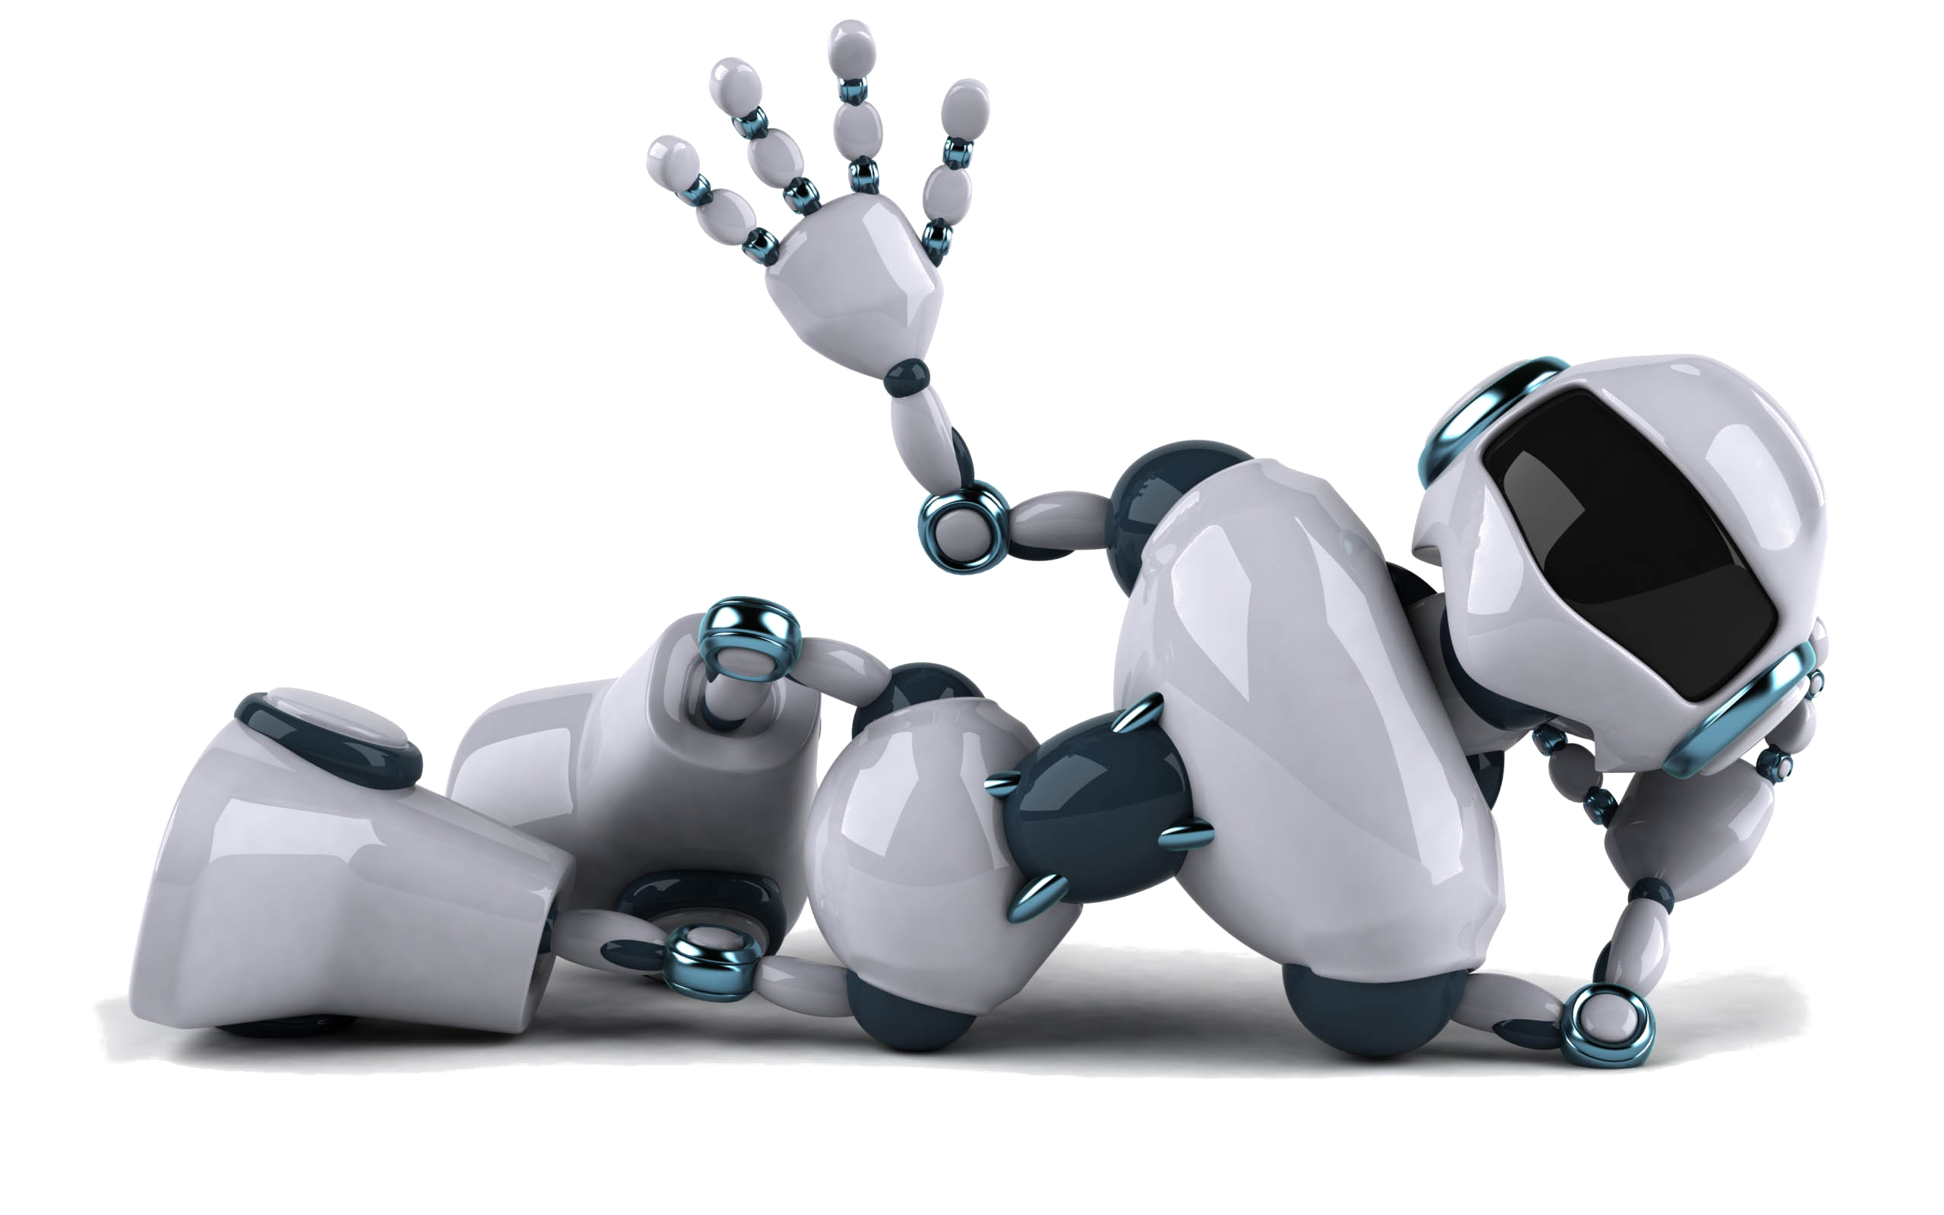
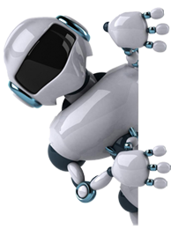
I Robotics
Date: DD/MM/JJJJ

Slide 2
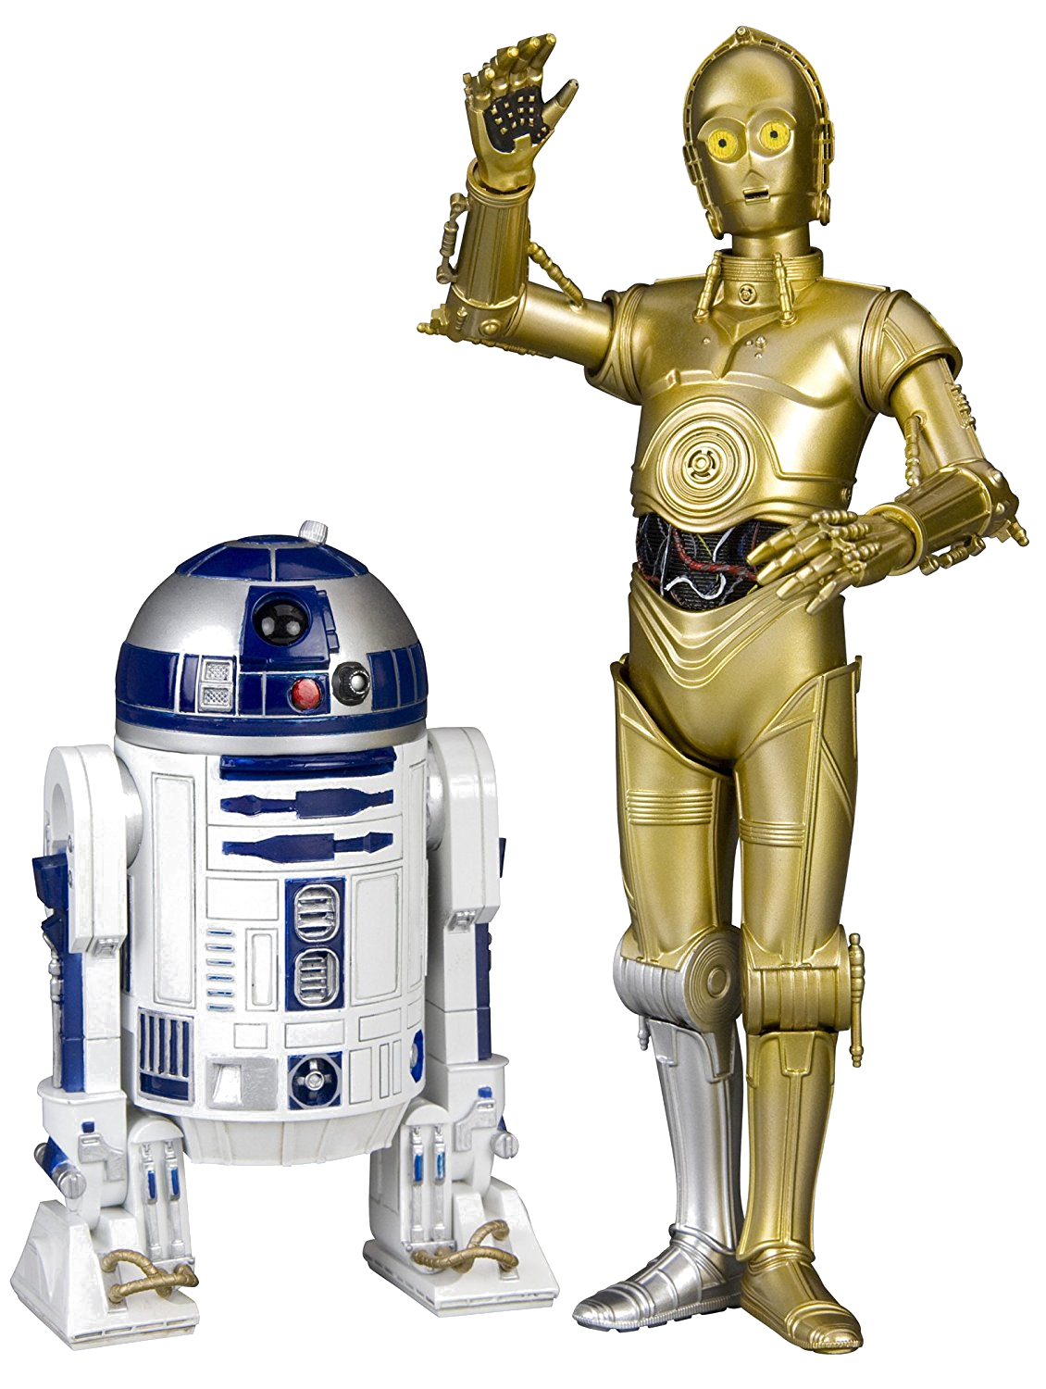
R2-D2 and C-3PO
Star wars and all science fiction robots are not true robots, they can talk, walk and do things people can do

Slide 3
Video 1
Real robots today are designed for specific tasks like transporting people and cars assembling products in a factory and they can only do the specific tasks for which the were designed.
This means they don't look always like human, don't talk, walk etc) their shapes and sizes are designed to fit the specific tasks they do.
Robots definition=are automated devices that perform physical tasks in the real world!

Slide 4

Daniela Rus Introduction to robotics
Robots have potential to improve the quality (at school, at home...), to power the economy and generally make the word better
The Objective of robotic is NOT to replace humans, it is to find ways for machines and humans to be more effective together Machine could become trusted partner this is a future we are building.

Slide 5
The world of pervasive robotic connect word of many robots working with many people doing many tasks.
Robots puts computation in motion: they are programmable mechanical devices that take inputs from the world through sensors and impact the world through their actuators Robots come in many different shapes
Humanoid shapes are not the only, robot can be a car, a shopping cart, a garbage a device to deliver a package....
An example of automation could lead in the future to a completely new shopping experience. Where robots can deliver packages, clean up, move things around, these robots have to (Pic.2) move in the world: they have to sense, compute, and move in support of their tasks, they have all to interact with each other and with people in support of their coordination tasks

Slide 6
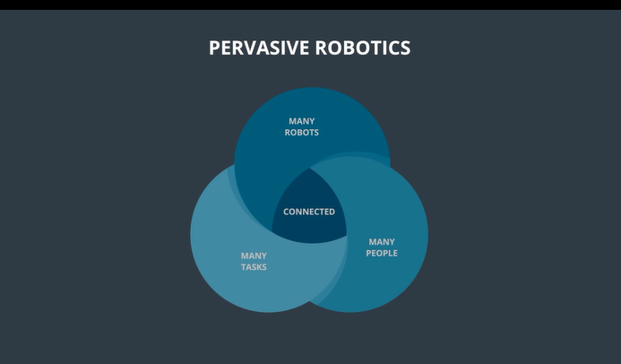
Pervasive robotic

Slide 7
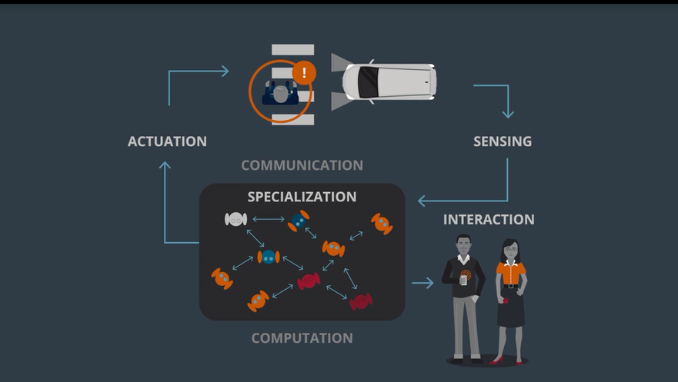
Where robots can deliver packages

Slide 8
Computation has improved dramatically, power of computing doubles every 2 year
Robot are bodies and brains
Bodies are formed from of Mechanisms that include computation, sensing, actuation, communication brain to control the bodies and this are done by algorithms Autonomous driving is an example on how driving will evolve is an extraordinary path, were transportation will become an Utility

Slide 9
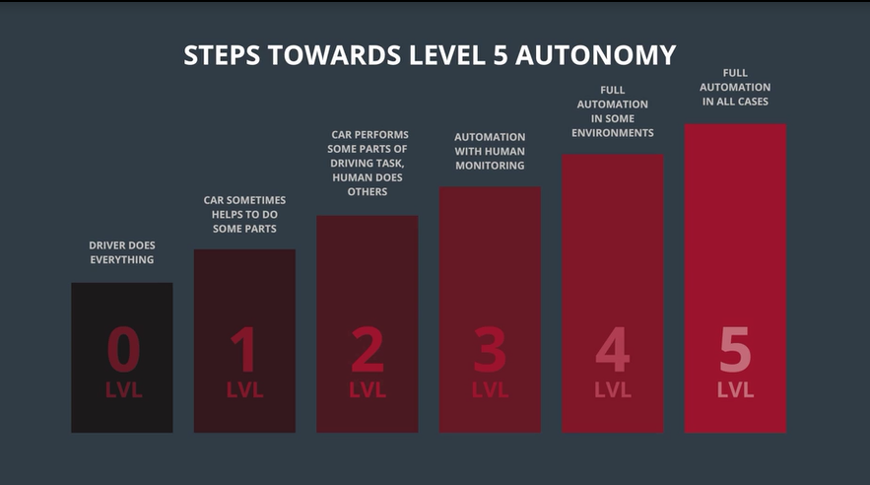
were transportation will become an Utility

Slide 10
Autonomous systems
DRIVE, SENSE
PHASE I
(ONCE, THEN INCREMENTAL UPDATES)
COMPUTE MAP FOR
CLOSED REGION
PLAN PATH
PHASE II
(EACH RIDE)
DRIVE
Notes:
Video2, Alex

Slide 11
Feature SpaCe
MAPPING
LOCALIZATION
NAVIGATION
PEDESTRIAN DETECTION
PEDESTRIAN INTERACTION
VEHICLE INTERACTION
Notes:
Feature space just refers to the collections of features that are used to characterize your data. For example, if your data is about people, your feature space might be (Gender, Height, Weight, Age) ... Cars?

Slide 12
AUTONOMY ARCHITECTURE
INFRASTRUCTURE
PERCEPTION
SENSING
ESTIMATION
PLANNING/
CONTROLLING
ROBOT
PLATFORM

Slide 13
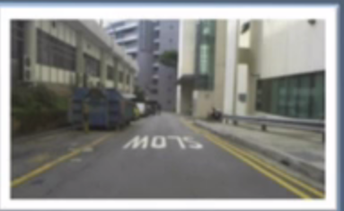
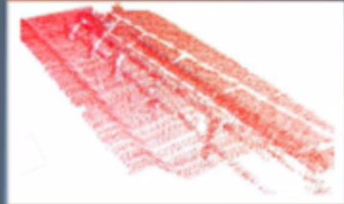

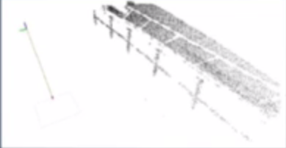
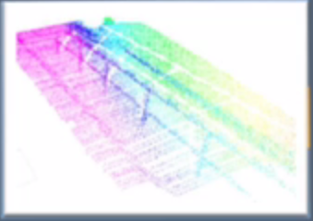
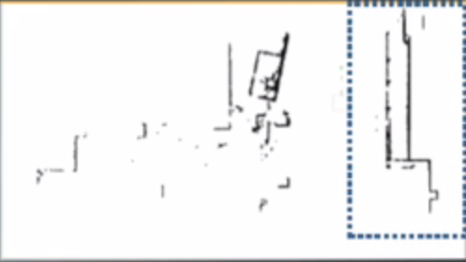
Mapping
Laser Scanners
SURFACE NORMAL
CALCULATIONS
POINT
CLASSIFICATION
INTEREST POINTS
LIDAR accumulation
3D rolling window
SYNTHETIC LIDAR CONSTRUCTION

Slide 14
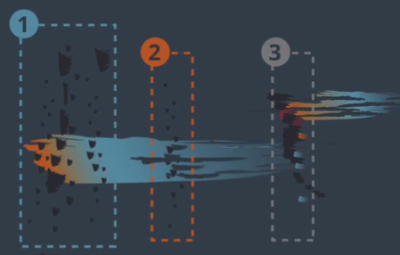
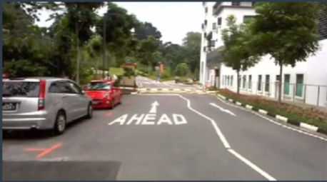
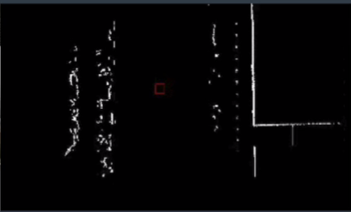
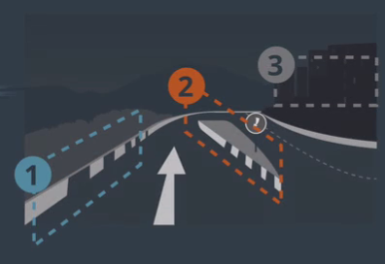
Localization
Surface Normal For Classification
ON-BOARD
CAMERA VIEW
TOP-DOWN
LASER SCAN VIEW
CLASSIFICATION

Slide 15
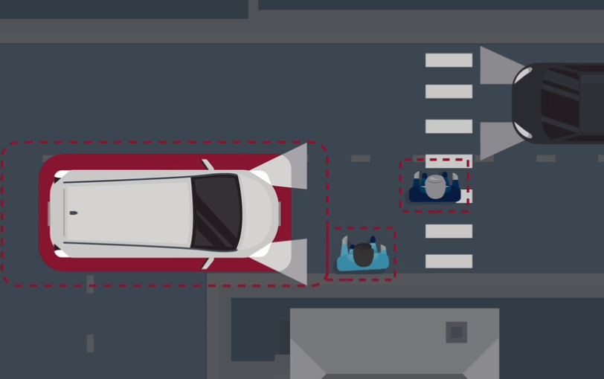
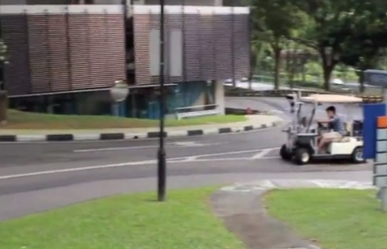
PEDESTRIANS
NAVIGATION & INTERACTION
TRADITIONAL NAVIGATION SYSTEM
DYNAMIC VIRTUAL BUMPER
IMPLEMENTED TRAFFIC RULES
BREAK TRAFFIC RULES

Slide 16
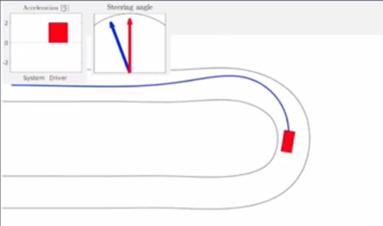
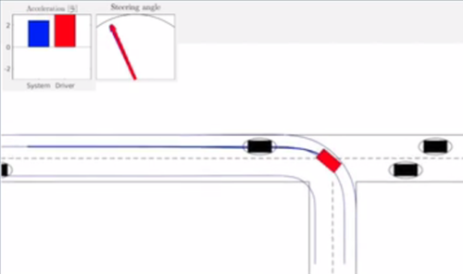
VEHICLE INTERACTION
ConSTRAINT OPTIMIZATION
SHARED CONTROLLER
LOW-LEVEL COMMANDS
SAFE MODIFICATIONS
Notes:
you can see the speed in bars, the steering angle in arrows
blue = decision of autonomy system
red = decision of human

Slide 17
Video 3
TEXT

Slide 18

Whole World is on Fire Autonomous driving
TEXT

Slide 19
Video 4
Why is it so difficult for ROBOTICS to walk
Mobility: What´s easy & hard
Three main challenges for Robots
More skills for Robots
Create much faster new Body's
Getting Robots much better between Robots & People
Shared control between Human & Mobility

Slide 20
Whole World is on Fire Autonomous driving
Why is it so difficult for ROBOTICS to walk

Slide 21
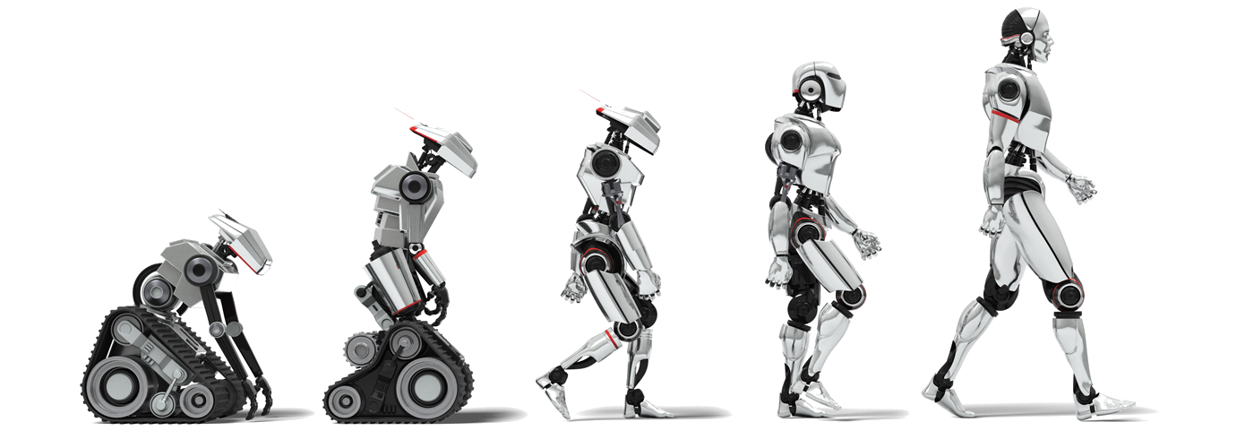
Science fiction “Robots” walks
“Autonomous driving” in other words Robots on Wheels is the Future Peak.
Brain to control the Body to do the Task.
Capabilities of the Body relative to the Task.
Robots needs a very quick reaction
to the surrounding World.
Extraordinary perception.
Negotiate the next steps, Robots needs a very quick reaction, need extraordinary perception

Slide 22
Whole World is on Fire Autonomous driving
What´s easy & hard

Slide 23

Mobility is much easier as manipulation
Easy
Excellent sensors that enable Machines
Good bundle of algorithms
Hard
Movement on congestions streets
Manipulation is challenging
Robots have limited capabilities
Developing Soft Robotics that have Human movements

Slide 24
Whole World is on Fire Autonomous driving
Three main challenges for Robots

Slide 25
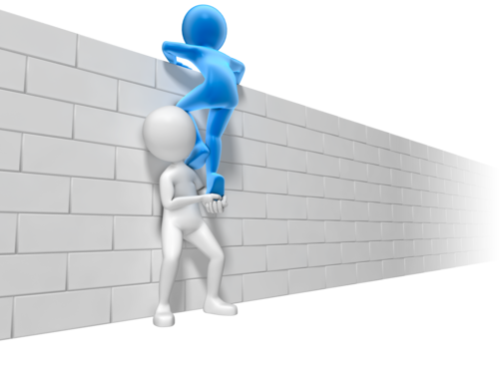
More skills for Robots
Robots could be integrated in human Environment
Work with Human who are not expert
Create much faster new Body's
Ernom time to create new type of Robots
Task Reserved for few experts
Getting Robots much better between Robots & People
Future able to execute a wide range of task

Slide 26
Whole World is on Fire Autonomous driving
Shared control between Human & Mobility

Slide 27
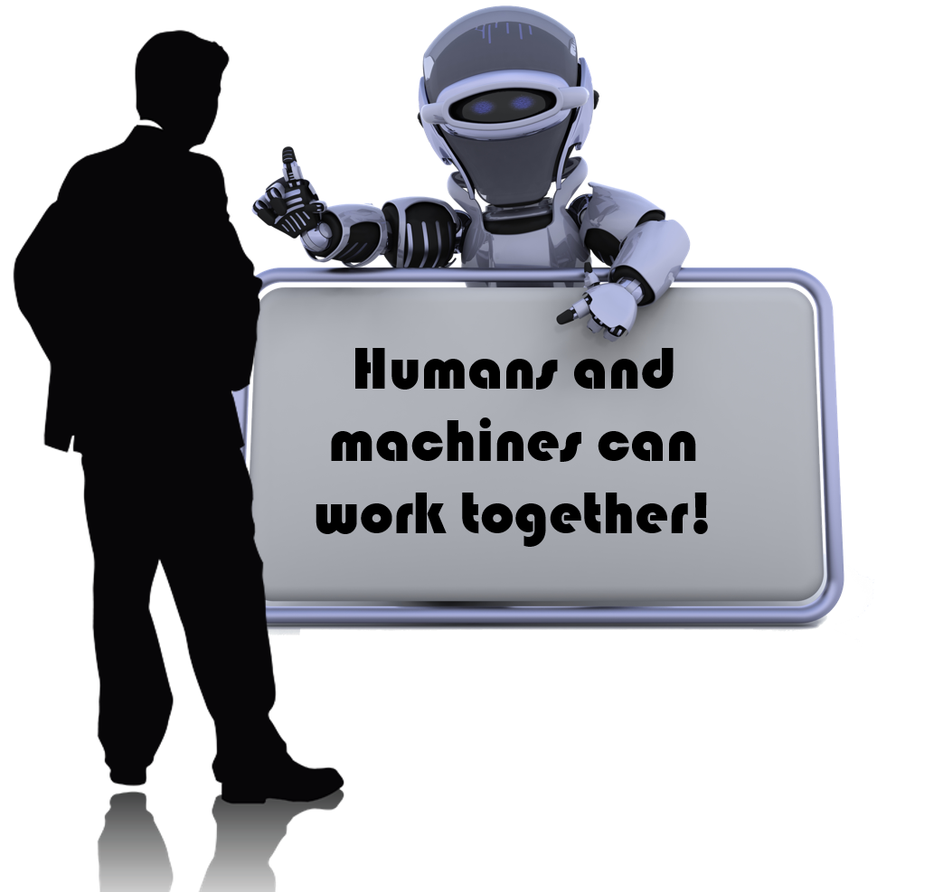
Shared Control between Human & Maschines
Maschines can do much better then Human(See further)
Principal taking advantage what Maschines could do better then People
Could get awareness what´s happening around
Future Working together

